Slide 1
COMPUTER VISION
BY
A CHARAN REDDY

Slide 2
CONTENT
Introduction to computer-vision.
Relationship between computer vision and various other fields.
Application of computer vision
Advantages of computer vision
Disadvantages of computer vision
Application fields

Slide 3
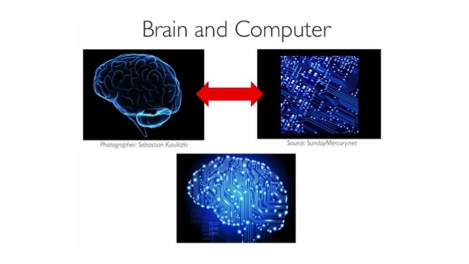

Slide 4
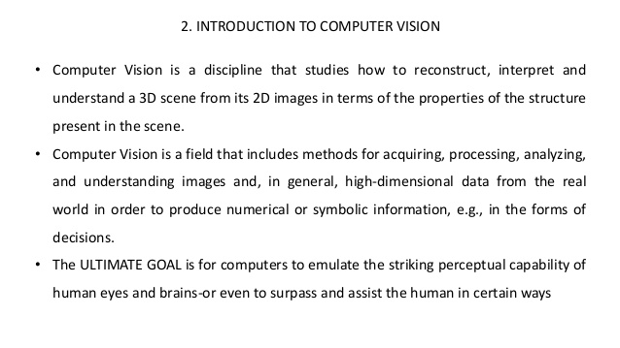


Slide 5
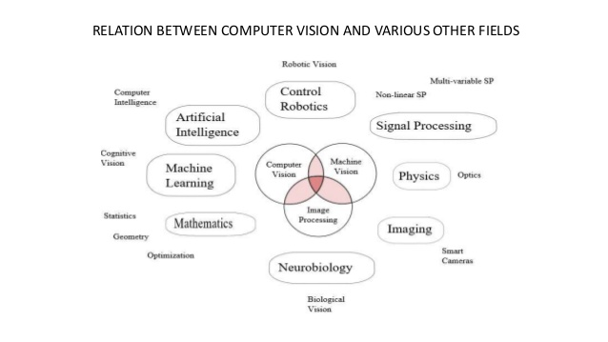

Slide 6
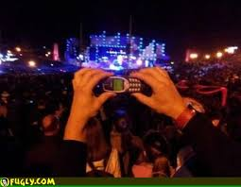
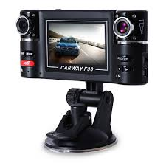
2.0mp to 1000mp(gigapixel image)

Slide 7
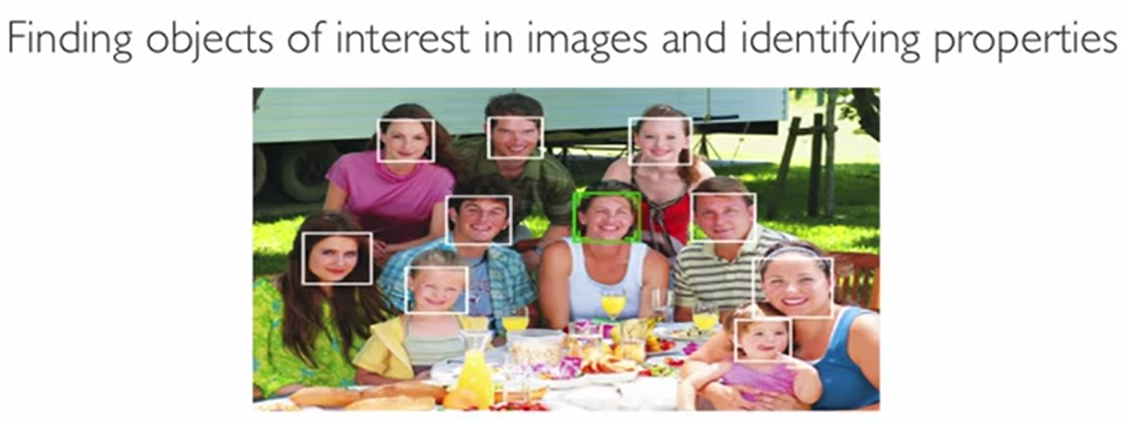
3. APPLICATIONS OF COMPUTER VISION
(a) FACE DETECTION
Face detection can be regarded as a specific case of object-class detection. In object-class detection, the task is to find the locations and sizes of all objects in an image that belong to a given class.
Face-detection algorithms focus on the detection of frontal human faces. It is analogous to image detection in which the image of a person is matched bit by bit.

Slide 8
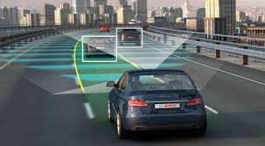
(b)Self driving cars

Slide 9
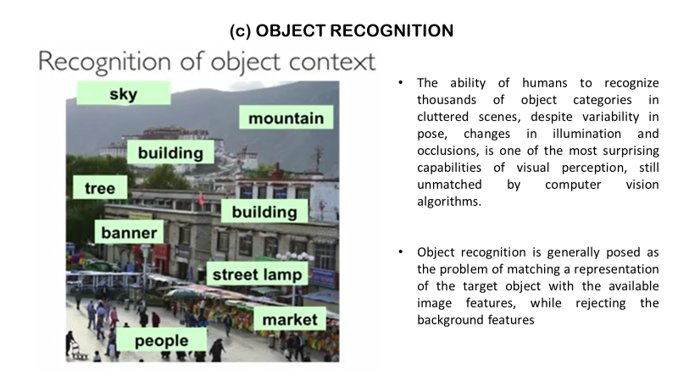

Slide 10
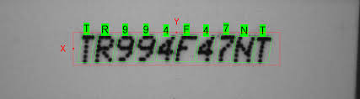
ocr
Optical character recognition
Technology to convert scanned docs to text.

Slide 11
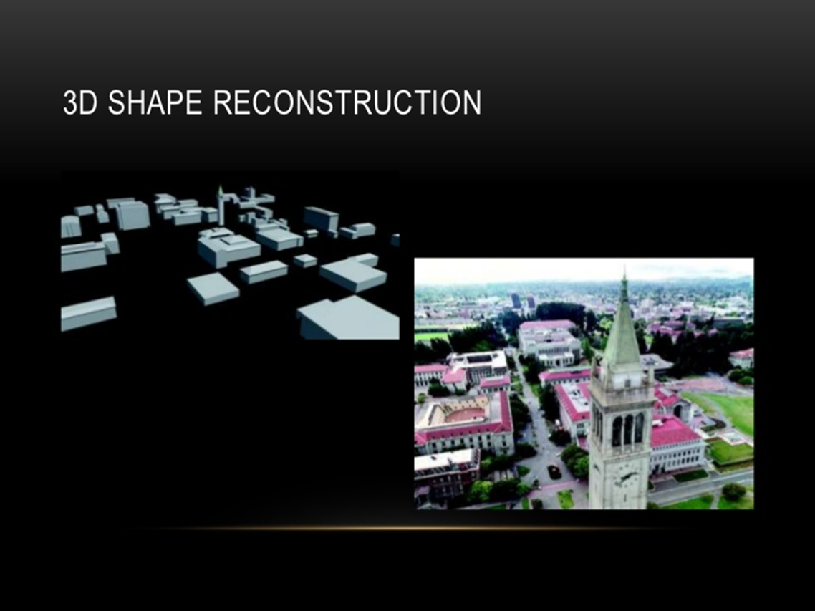

Slide 12
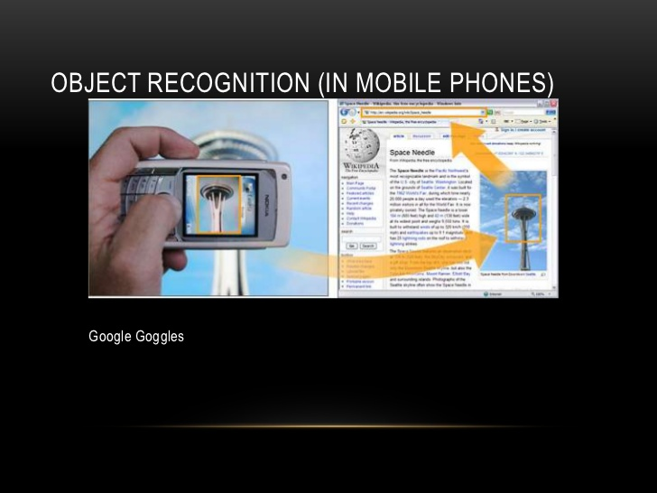

Slide 13

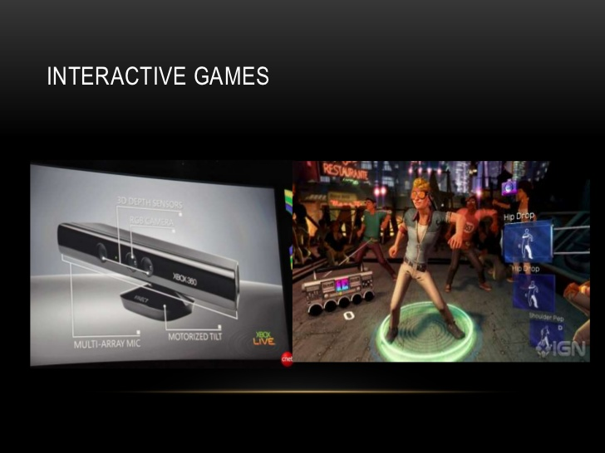

Slide 14
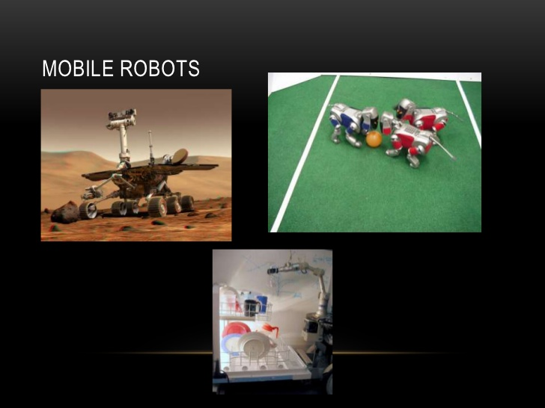

Slide 15
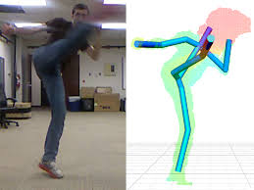
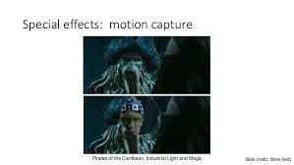
Shape capture & motion capture

Slide 16
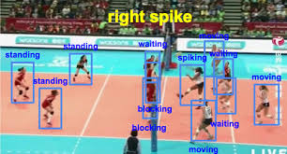
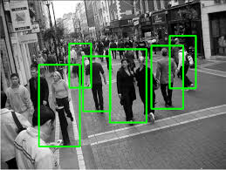
Sports ,security and serveillance

Slide 17
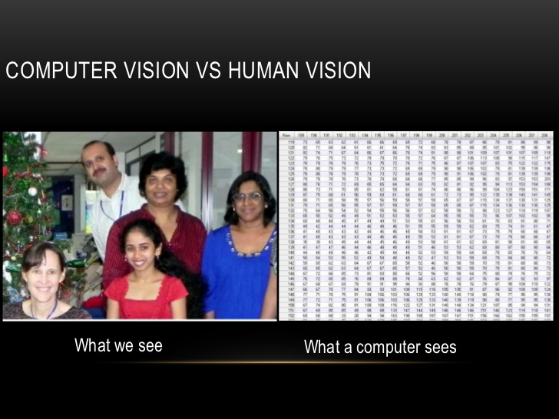

Slide 18
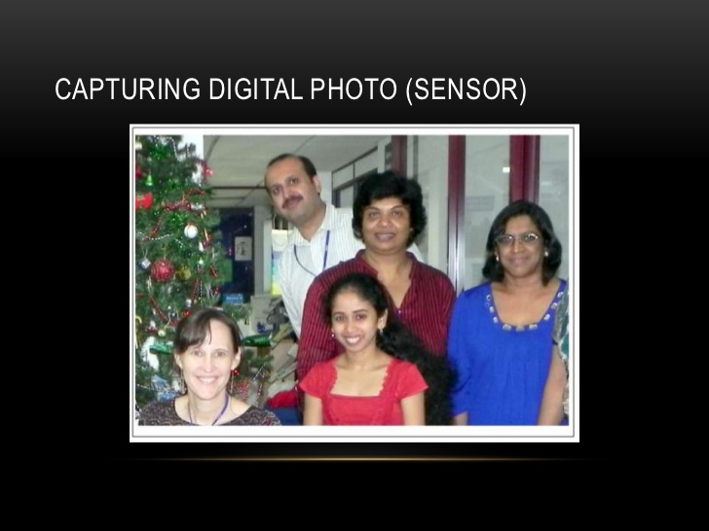
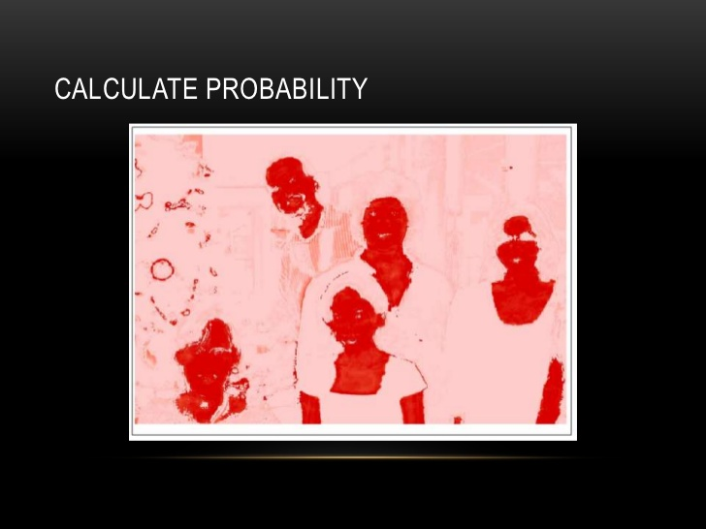
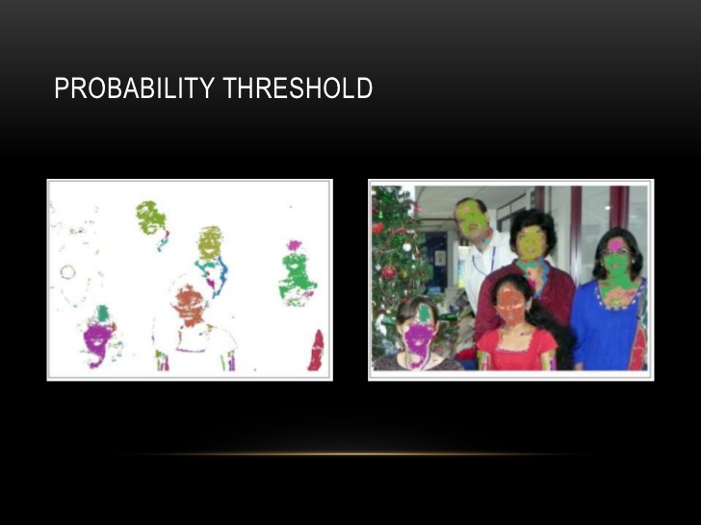
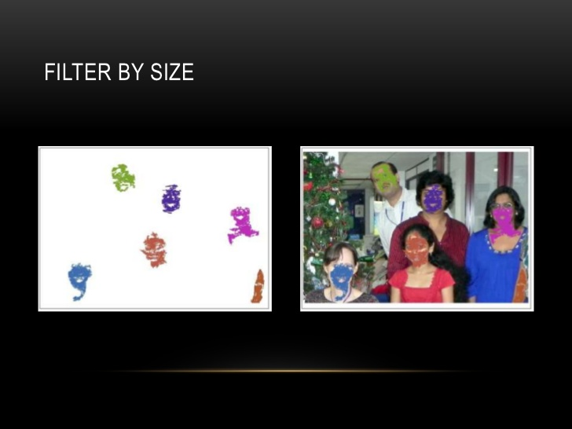
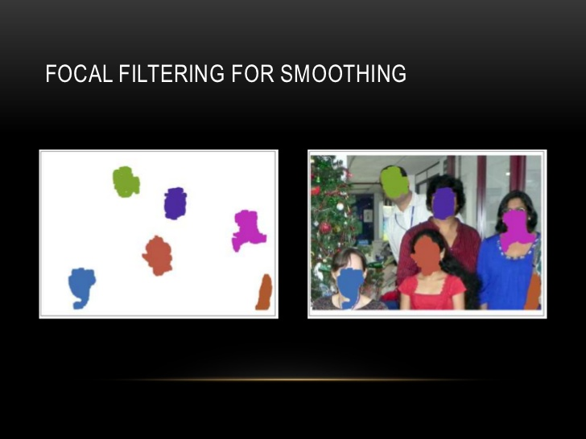
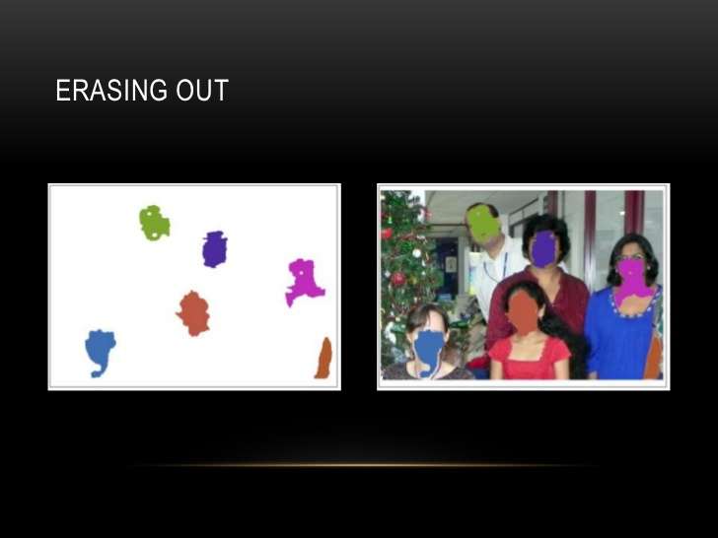
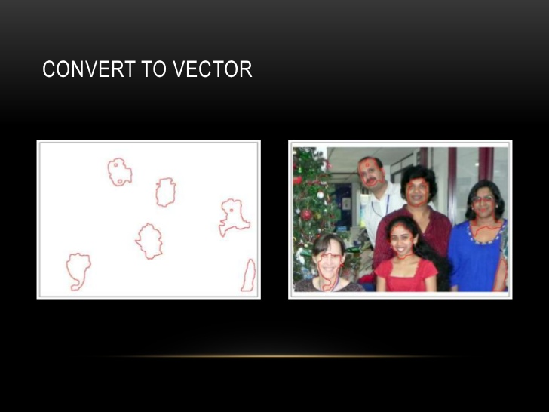
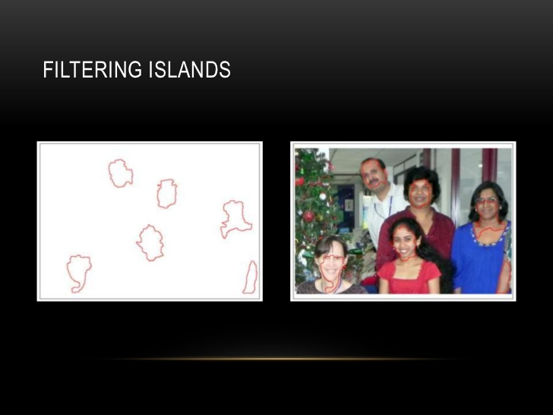

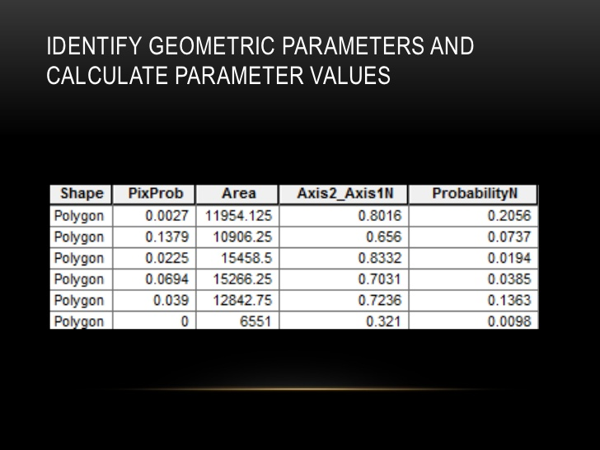

Slide 19
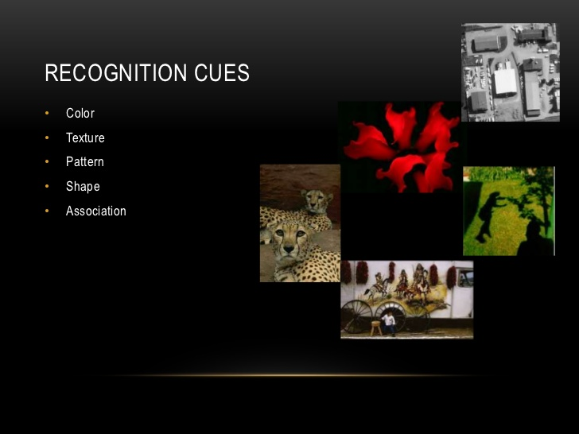

Slide 20
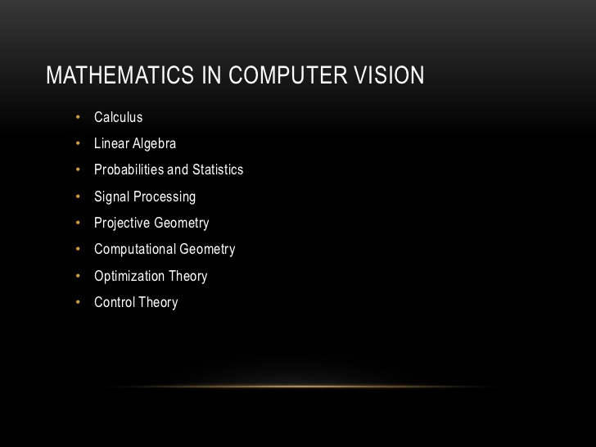

Slide 21
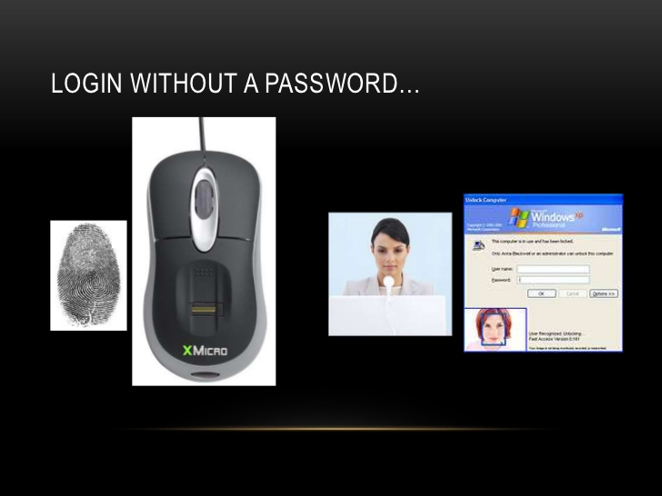

Slide 22
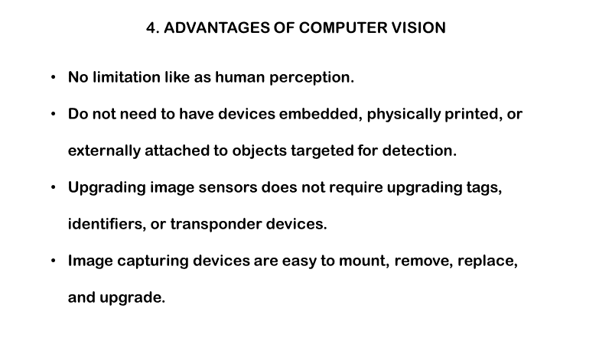

Slide 23
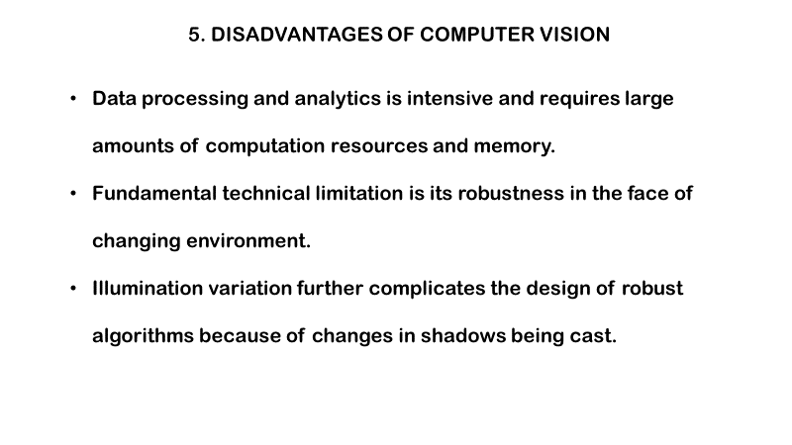

Slide 24
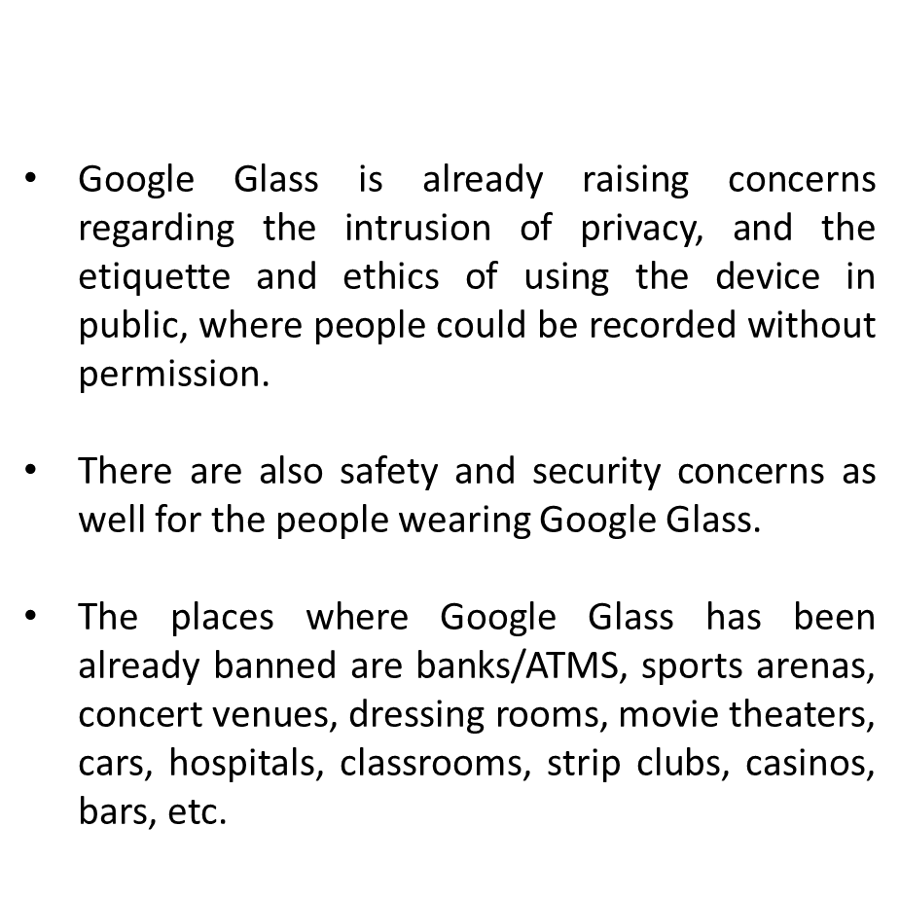
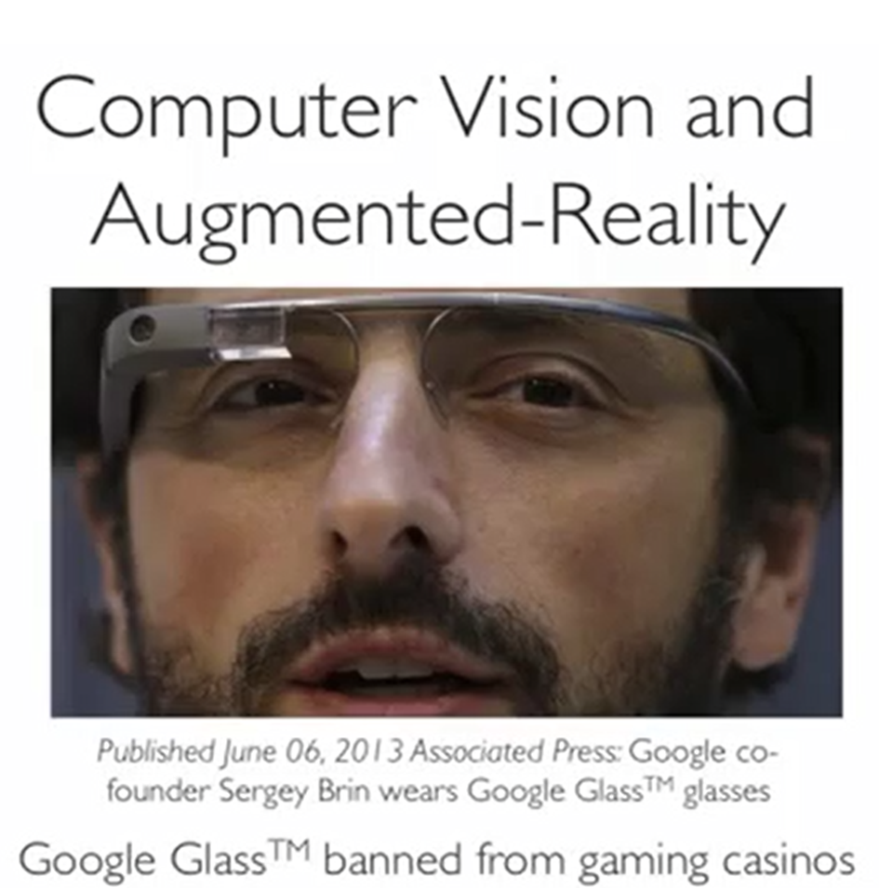

Slide 25
Application fields:
Agriculture
augmented reality
autonomous vehicles
Biometrics
character recognition
Forensics
industrial quality inspection
face recognition
gesture analysis
Geoscience
image restoration
medical image analysis
pollution monitoring
process control
remote sensing
Robotics
security and surveillance
transport

Slide 26


